Slide 1
JavaScript DOM

Slide 2
The document object represents the whole html document.
When html document is loaded in the browser, it becomes a document object. It is the root element that represents the html document. It has properties and methods. By the help of document object, we can add dynamic content to our web page.
Properties of document object
Let's see the properties of document object that can be accessed and modified by the document object.

Slide 3
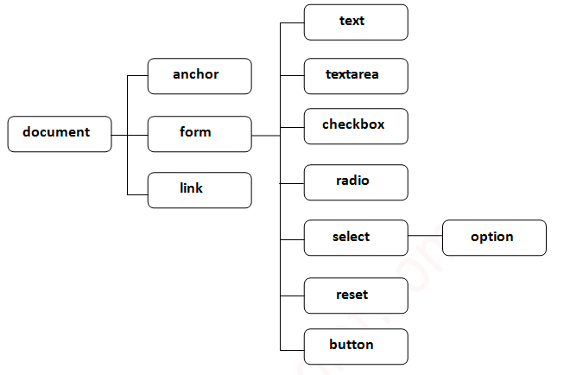

Slide 4
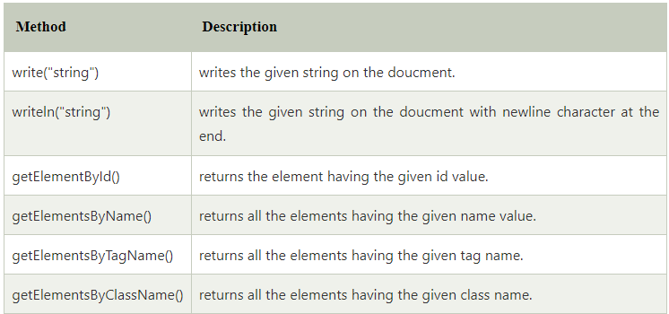
Methods of document object
We can access and change the contents of document by its methods.

Slide 5
Accessing field value by document object
In this example, we are going to get the value of input text by user. Here, we are using document.form1.name.value to get the value of name field.
Here, document is the root element that represents the html document.
form1 is the name of the form.
name is the attribute name of the input text.

Slide 6
<script type="text/javascript">
function printvalue(){
var name=document.form1.name.value;
alert("Welcome: "+name);
}
</script>
<form name="form1">
Enter Name:<input type="text" name="name"/>
<input type="button" onclick="printvalue()" value="print name"/>
</form>

Slide 7
getElementById() method
The document.getElementById() method returns the element of specified id.
we can use document.getElementById() method to get value of the input text. But we need to define id for the input field.
<script type="text/javascript">
function getcube(){
var number=document.getElementById("number").value;
alert(number*number*number);
}
</script>
<form>
Enter No:<input type="text" id="number" name="number"/><br/>
<input type="button" value="cube" onclick="getcube()"/>
</form>

Slide 8
GetElementsByClassName()
The getElementsByClassName() method is used for selecting or getting the elements through their class name value.
This DOM method returns an array-like object that consists of all the elements having the specified classname.
On calling the getElementsByClassName() method on any particular element, it will search the whole document and will return only those elements which match the specified or given class name.

Slide 9
Example of getElementsByClassName() Method
<body>
<div class="Class">
This is a simple class implementation
</div>
<script type="text/javascript">
document.getElementsByClassName('Class')[0].style.backgroundColor = 'red';
</script>
</body>

Slide 10
getElementsByName() method
The document.getElementsByName() method returns all the element of specified name.
<script type="text/javascript">
function totalelements()
{
var allgenders=document.getElementsByName("gender");
alert("Total Genders:"+allgenders.length);
}
</script>
<form>
Male:<input type="radio" name="gender" value="male">
Female:<input type="radio" name="gender" value="female">
<input type="button" onclick="totalelements()" value="Total Genders">
</form>

Slide 11
getElementsByTagName() method
The document.getElementsByTagName() method returns all the element of specified tag name.
Example of document.getElementsByTagName() method
In this example, we going to count total number of paragraphs used in the document. To do this, we have called the document.getElementsByTagName("p") method that returns the total paragraphs.

Slide 12
<script type="text/javascript">
function countpara(){
var totalpara=document.getElementsByTagName("p");
alert("total p tags are: "+totalpara.length);
}
</script>
<p>This is a pragraph</p>
<p>Here we are going to count total number of paragraphs by getElementByTagName() method.</p>
<p>Let's see the simple example</p>
<button onclick="countpara()">count paragraph</button>

Slide 13
Javascript - innerHTML
The innerHTML property can be used to write the dynamic html on the html document.
It is used mostly in the web pages to generate the dynamic html such as registration form, comment form, links etc.
In this example, we are dynamically writing the html form inside the div name having the id mylocation. We are identifing this position by calling the document.getElementById() method.

Slide 14
<html>
<body>
<script type="text/javascript" >
function showcommentform() {
var data="Name:<br><input type='text' name='name'><br>Comment:<br><textarea rows='5' cols='50'></textarea><br><input type='submit' value='comment'>";
document.getElementById('mylocation').innerHTML=data;
}
</script>
<form name="myForm">
<input type="button" value="comment" onclick="showcommentform()">
<div id="mylocation"></div>
</form>
</body>
</html>

Slide 15
Javascript - innerText
The innerText property can be used to write the dynamic text on the html document. Here, text will not be interpreted as html text but a normal text.
It is used mostly in the web pages to generate the dynamic content such as writing the validation message, password strength etc.
Javascript innerText Example
In this example, we are going to display the password strength when releases the key after press.

Slide 16
<script type="text/javascript" >
function validate() {
var msg;
if(document.myForm.userPass.value.length>5){
msg="good";
}
else{
msg="poor";
}
document.getElementById('mylocation').innerText=msg;
}
</script>
<form name="myForm">
<input type="password" value="" name="userPass" onkeyup="validate()">
Strength:<span id="mylocation">no strength</span>
</form>

